Slide 1
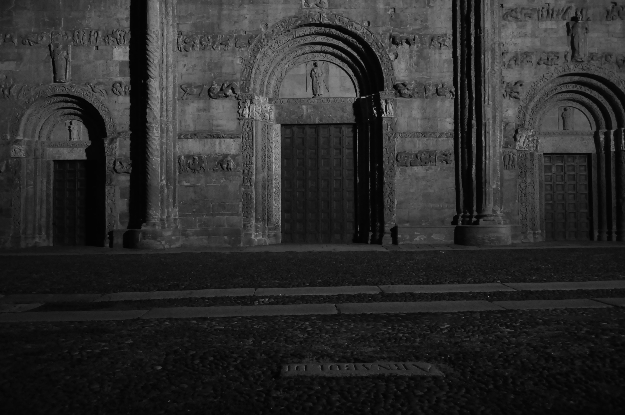
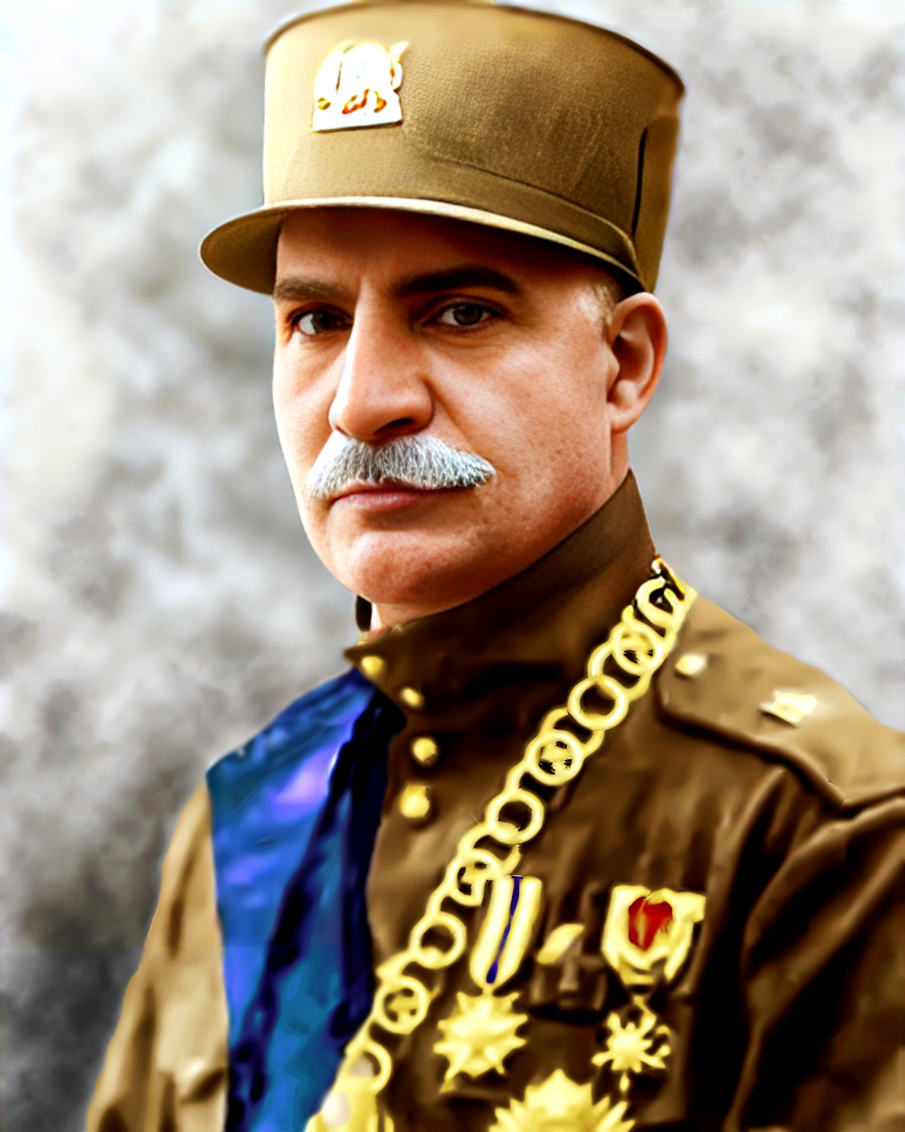
Who was Reza khan?

Slide 2
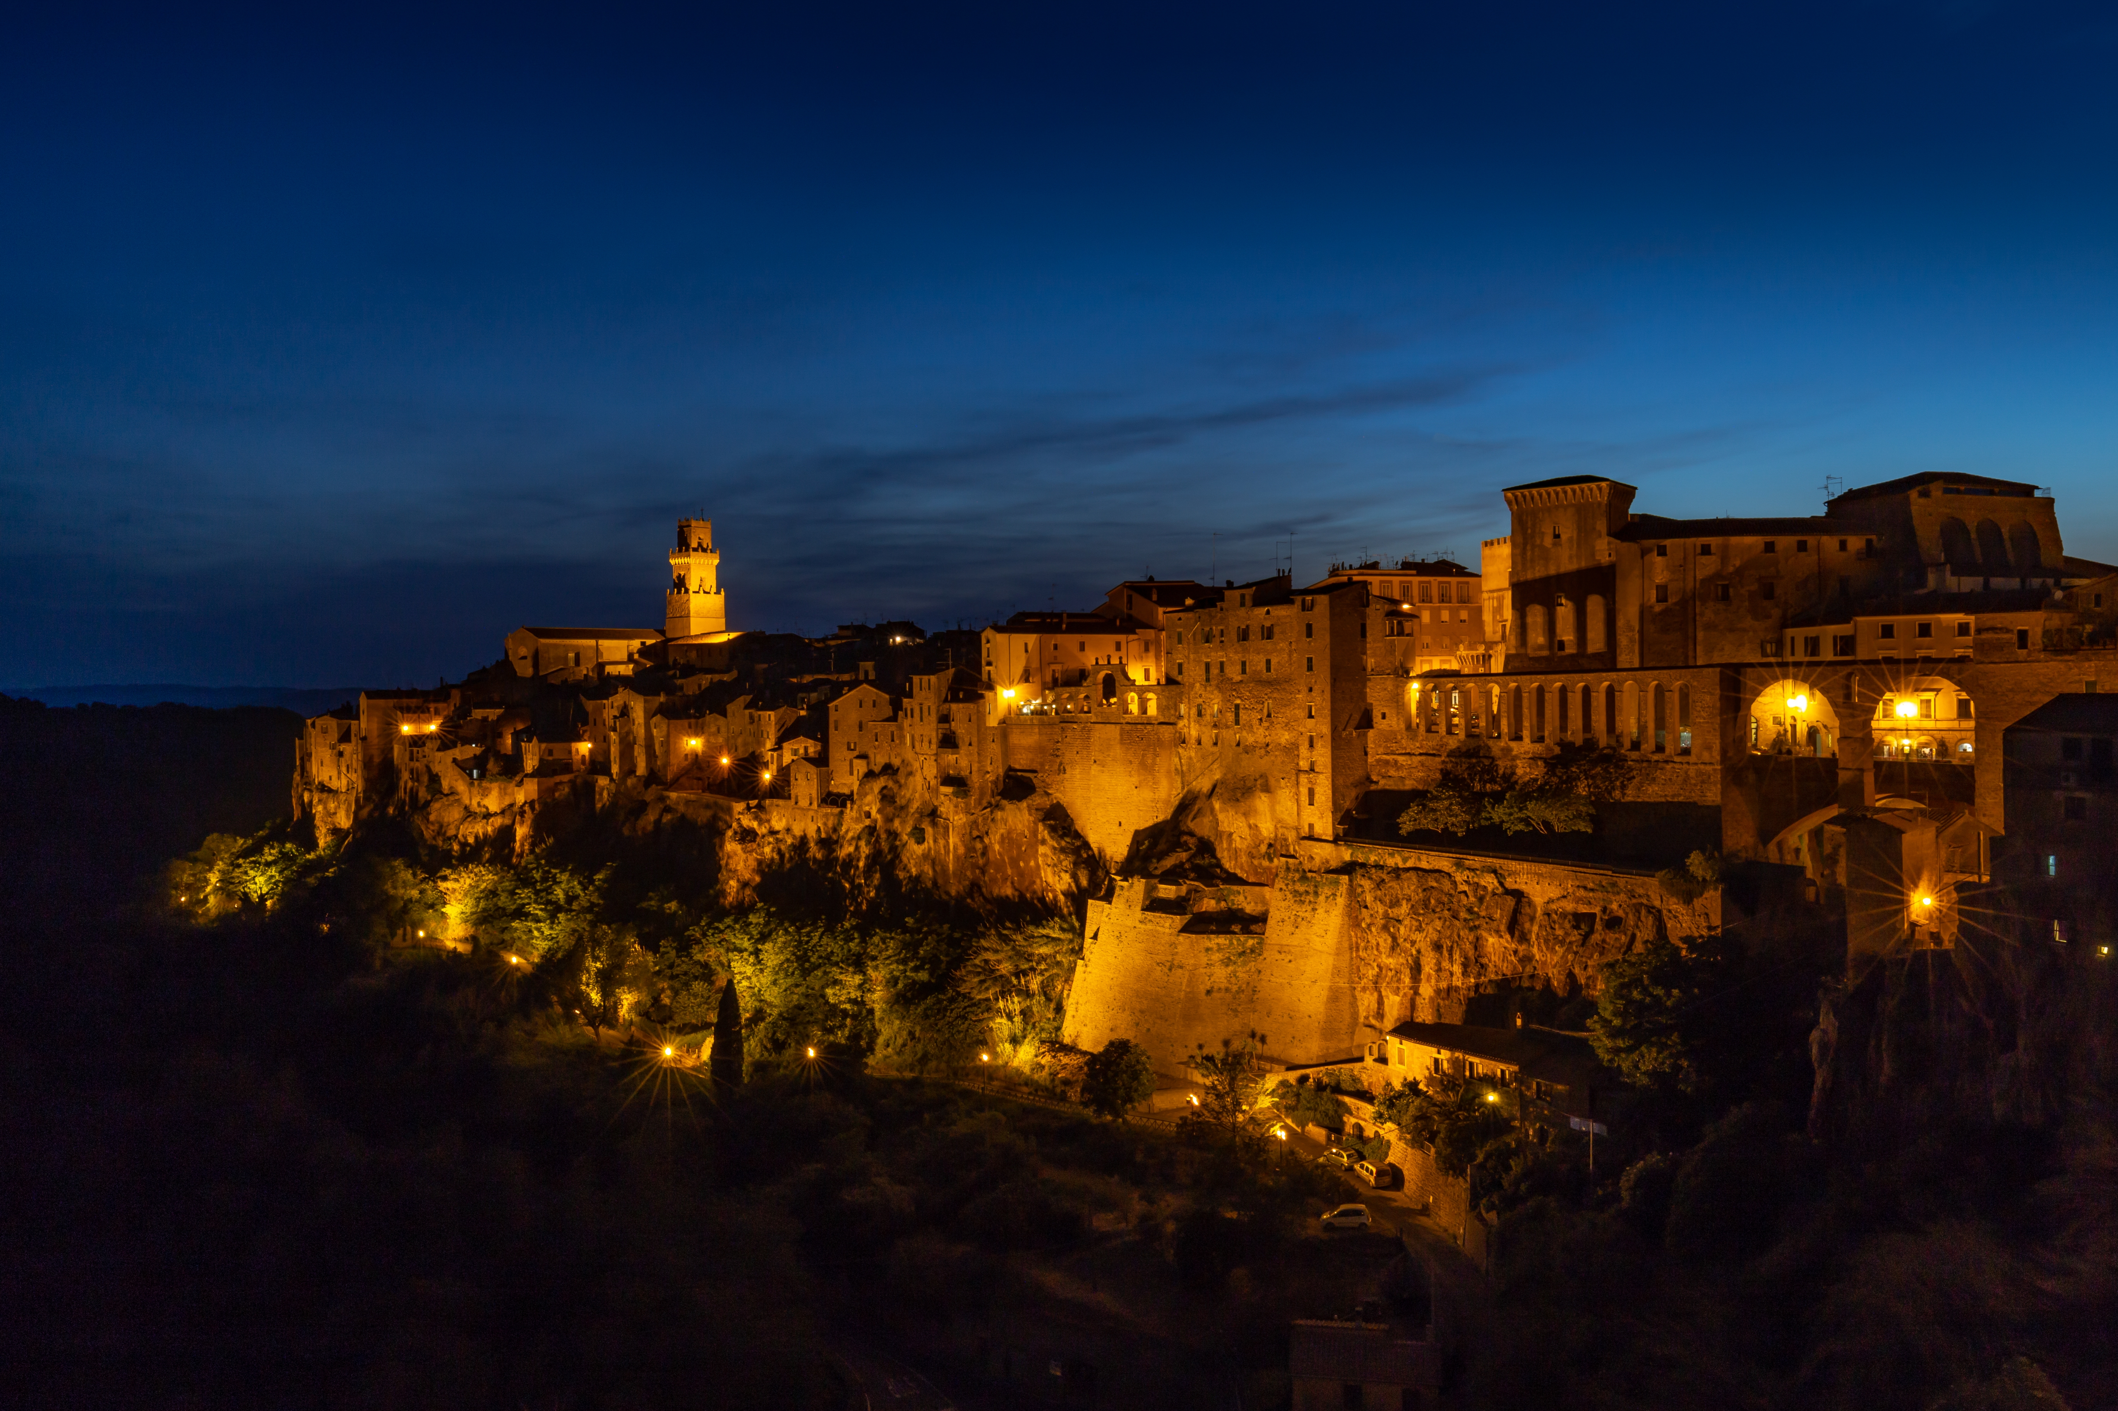
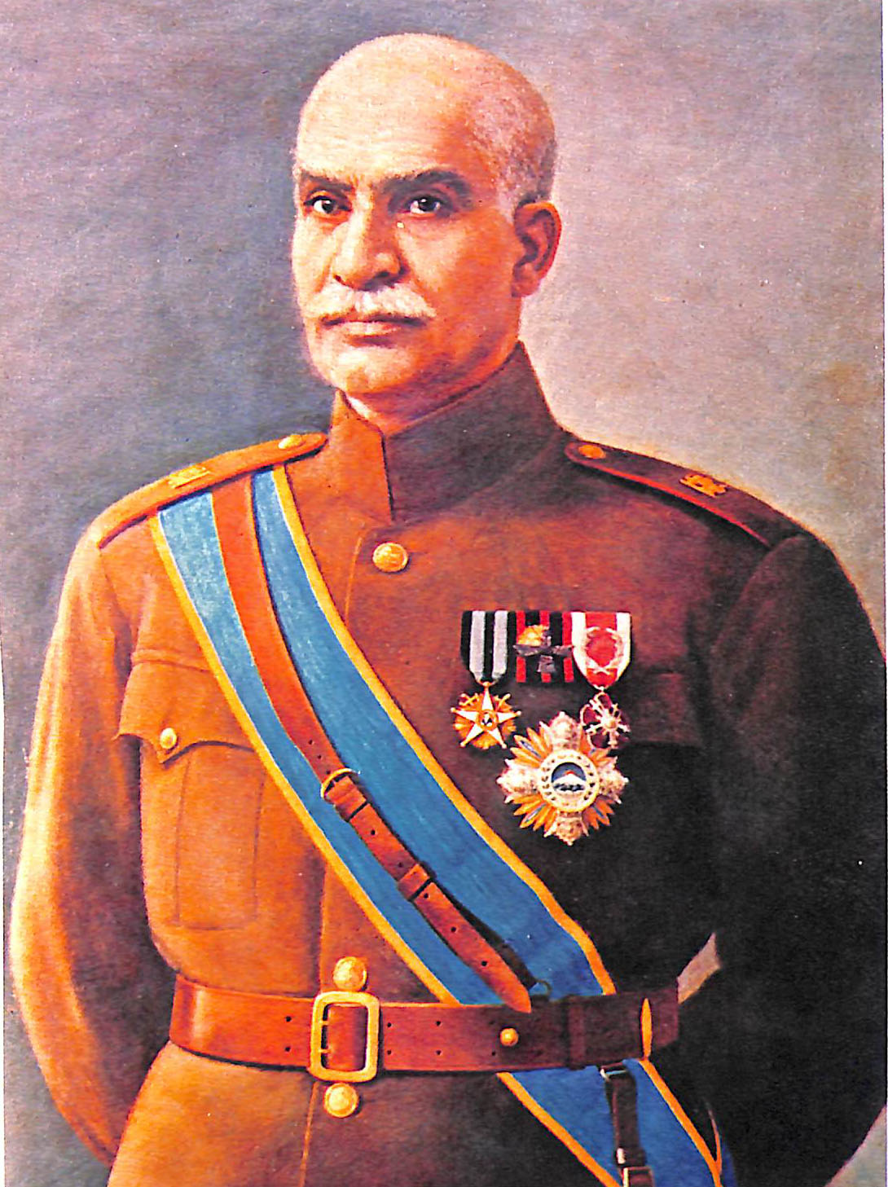
✅B: 1878
✅K: 1925 to 1941

Slide 3
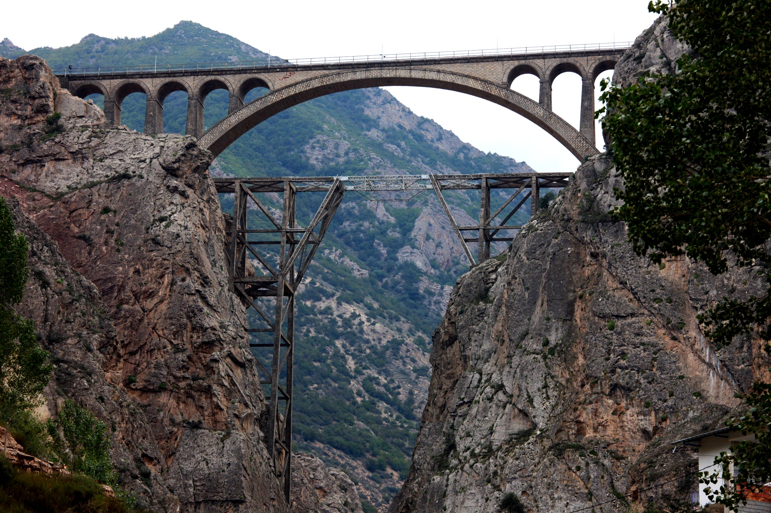
✅Railways
Versk Bridge

Slide 4
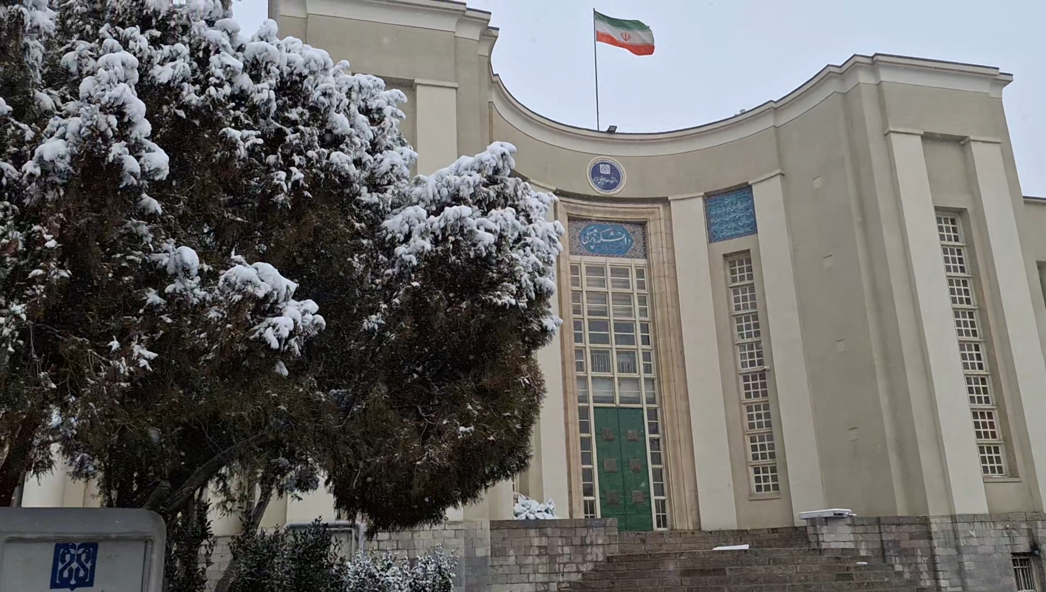
✅Modern university
University of Tehran

Slide 5
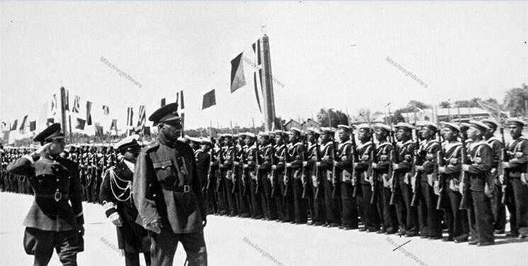
✅Army strong

Slide 6
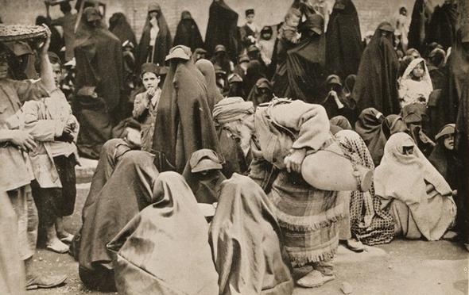
✅Women rights

Slide 7
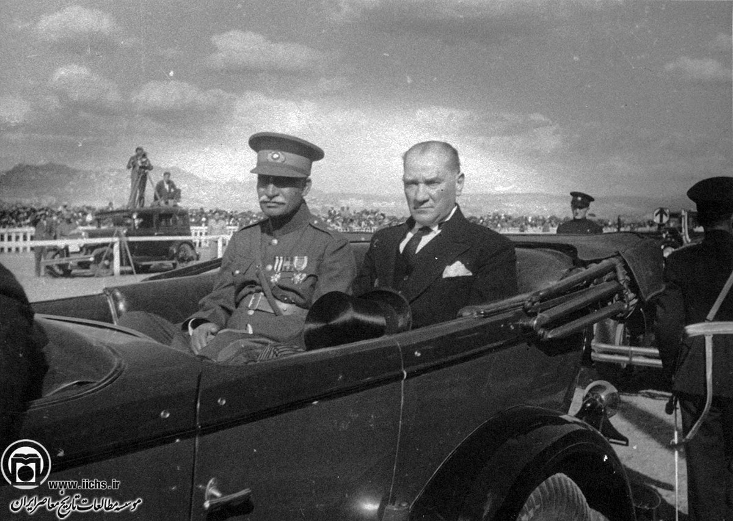
Reza Shah and Mustafa Kemal Atatürk

Slide 8
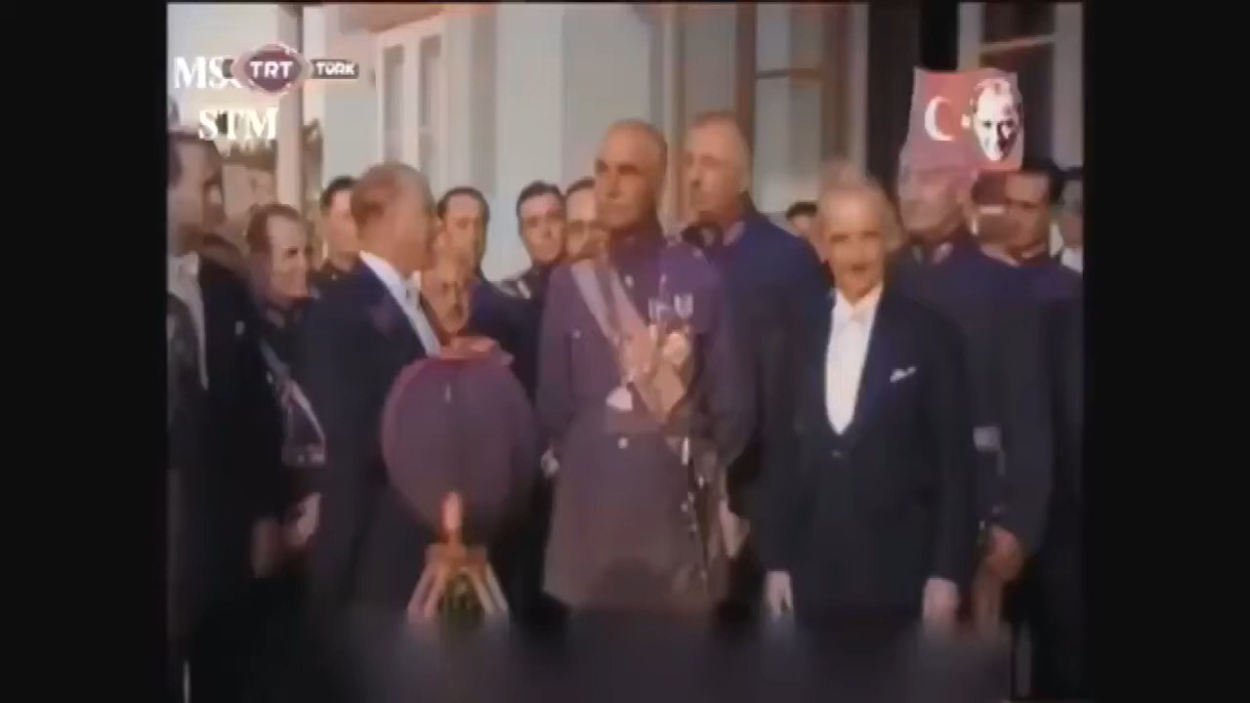
Turkey 1934

Slide 9
3 Advice from Atatürk
✅ Eliminating Islam
✅ Removing the Hijab
✅ Making Iran Modern

Slide 10
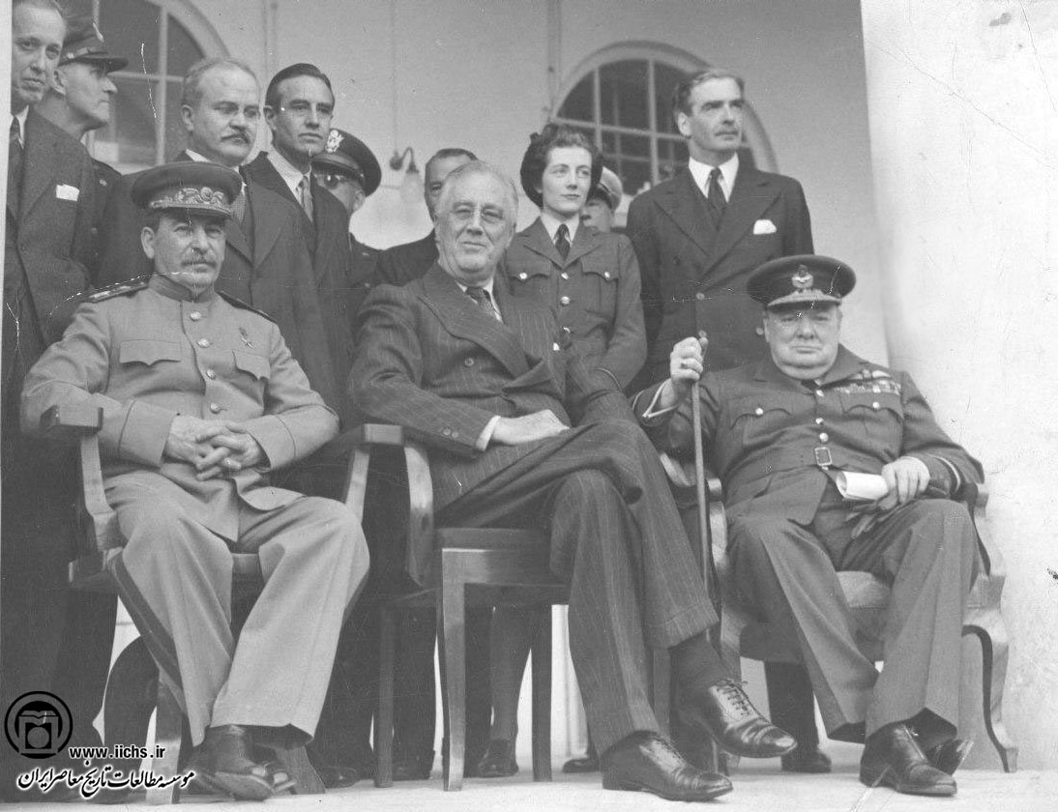
Churchill, Roosevelt and Stalin

Slide 11
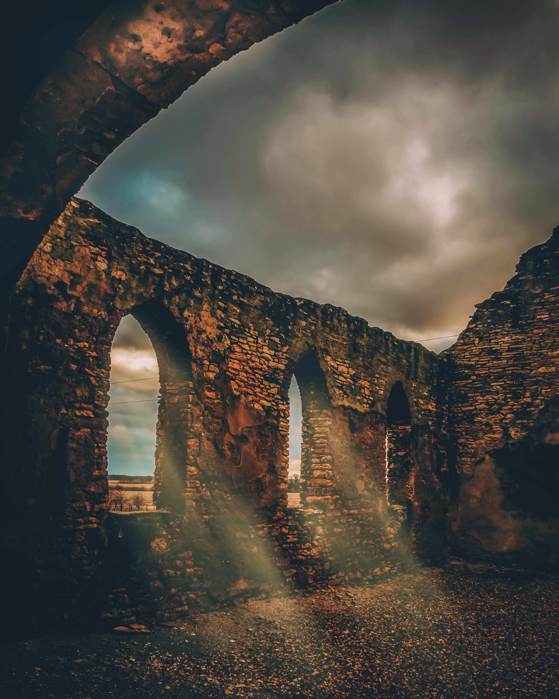
3 Advice from Atatürk
✅ Reza Shah made big changes in Iran
✅ He helped Iran move into the modern world
✅ But his way was very strict
✅ His story is important for understanding modern Iran
✅ D: 1944

